Slide 1
A Comparative Analysis of Usability and Engagement in Static and Animated Dashboard Interfaces
Research Design
Mariah Buhagiar CCD6.3A
Mentor: Kassandra Calleja

Slide 2
01
Aims & Objectives

Slide 3
Aims & Objectives
01
03
Problem
Aim
02
Research Gap
Dashboards present complex data, but the way they use animation can affect how easily users understand and interact with the information.
This study aims to explore how animation influences users’ perceived usability and engagement when interacting with dashboard interfaces.
Existing research discusses dashboard design and animation separately, but there is limited focus on comparing dashboards in this context.

Slide 4
Aims & Objectives
Hypothesis
Research Questions
Animation in dashboards enhances visual interest but interferes with focus during analytical tasks.
01
How do static and animated dashboard interfaces differ in terms of usability?
02
How do static and animated dashboard interfaces differ in terms of user engagement?
03
To what extent does animation improve or hinder the overall user experience of dashboard interfaces?

Slide 5
Significance & Contribution
Helps designers understand when animation is useful or distracting.
Contributes to HCI and dashboard interface design.
Provides practical design insight for financial dashboards.
Shows the importance of balancing engagement with clarity.

Slide 6
02
Methodology

Slide 7
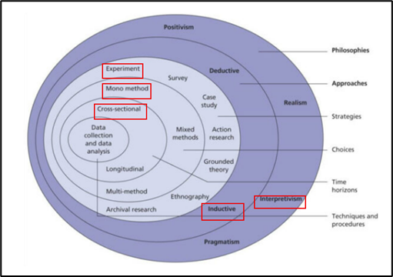
Research Onion
Philosophy:
Interpretivism
Approach:
Inductive
Strategy:
Experimental
Choice:
Mono-method qualitative
Time Horizon:
Cross-sectional
Techniques:
Observations & Semi-structured Interviews

Slide 8
Research Pipeline
01
03
05
07
Literature
Review
Hi-Fi Prototypes
Observations & Interviews
Findings
02
04
06
Dashboard Design
Participant Testing
Thematic Analysis

Slide 9
Validity & Reliability
Validity
Triangulation
Reliability
Audit Trail
Both dashboard versions used the same layout, content, and tasks, so animation remained the main design difference being studied.
Observation notes and interview responses were both used to compare what participants did with what they said.
Notes, coding decisions, and theme development were documented to keep the research process transparent.
Member Checking
All participants followed the same testing process, using the same tasks, observation method, and interview questions.
Key participant responses were checked to make sure their views were understood correctly.

Slide 10
Ethics & Considerations
Informed Consent: Participants were informed about the study before taking part.
Anonymity: Participants were referred to as Participant 1–6 rather than by name.
Voluntary Participation: Participants could stop taking part at any point
Data Handling: Observation notes and interview responses were only used for this assignment.
Low-Risk Study: The study involved simple dashboard interaction tasks and did not collect sensitive personal data.

Slide 11
03
Artefact Demo

Slide 12
04
Results & Discussion

Slide 13
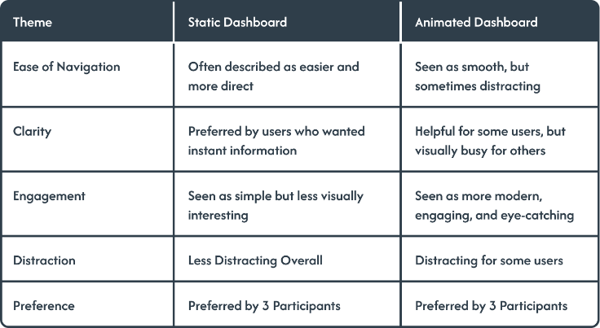
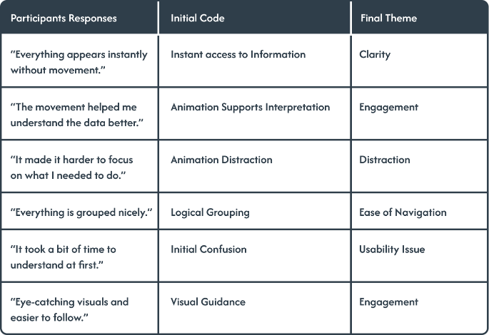
Results
Table 1: Theme Comparison
Table 2: Thematic Coding Process

Slide 14
Study objectives
RQ1
01
RQ2
02
RQ3
03
Bach et al. and Young & Kitchin
Static was generally more usable for users who wanted quick, distraction-free access.
support the importance of dashboard structure.
Animated was generally more engaging and visually appealing.
Shemy and Ge et al.
support the idea that motion can affect user perception.
Animation improved engagement but sometimes hindered focus.

Slide 15
05
Conclusion

Slide 16
Conclusion
Hypothesis Statement:
Overall, the findings supported the hypothesis. The animated dashboard increased visual interest and engagement, but it also interfered with focus for several participants during analytical tasks.
Limitations
Future Work
Small sample of 6 participants
Qualitative findings only
Short single-session testing
Larger participant sample
Quantitative measures such as SUS, task time, or error rate
Testing different animation types separately

Slide 17
Thank you!
Research Design

